Slide 1
CMU Rental Hub – Project Planning BIS 698 Information System Project
By Group - 9
Krishna Mohan Reddy Ailuri
Himabindu Mandem
Sai Prasanna Goduguluri
Sainikhil Reddy Pannala
Prahlada Reddy Kasani

Slide 2
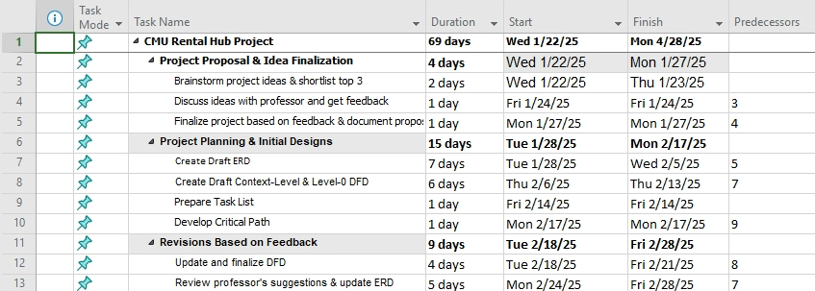
Project Task List & Timeline

Slide 3
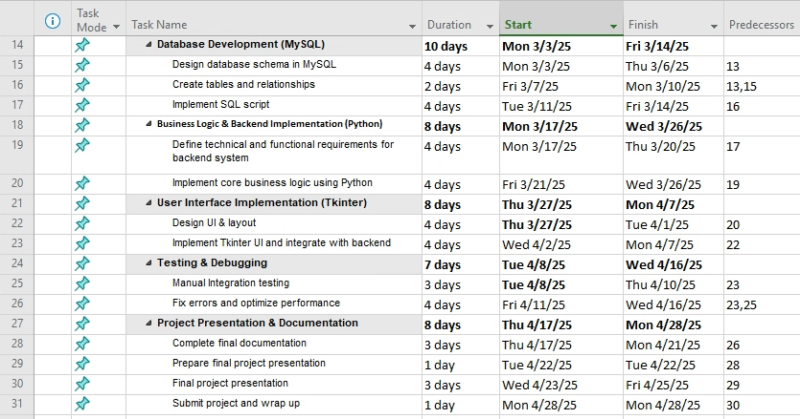
Tasks List - Project Prsentation & Documentation

Slide 4
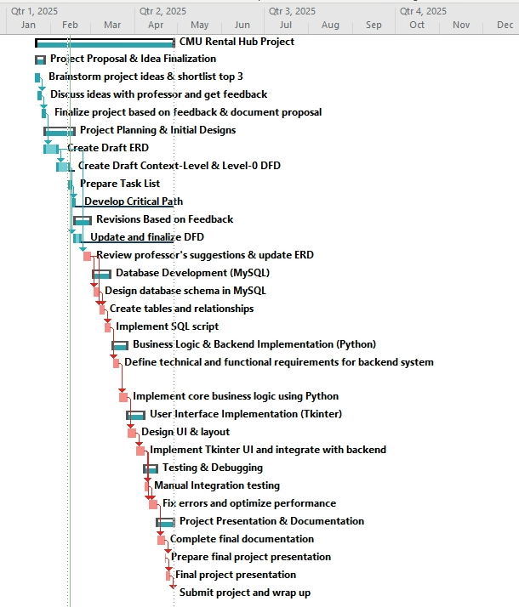
Critical Path

Slide 5
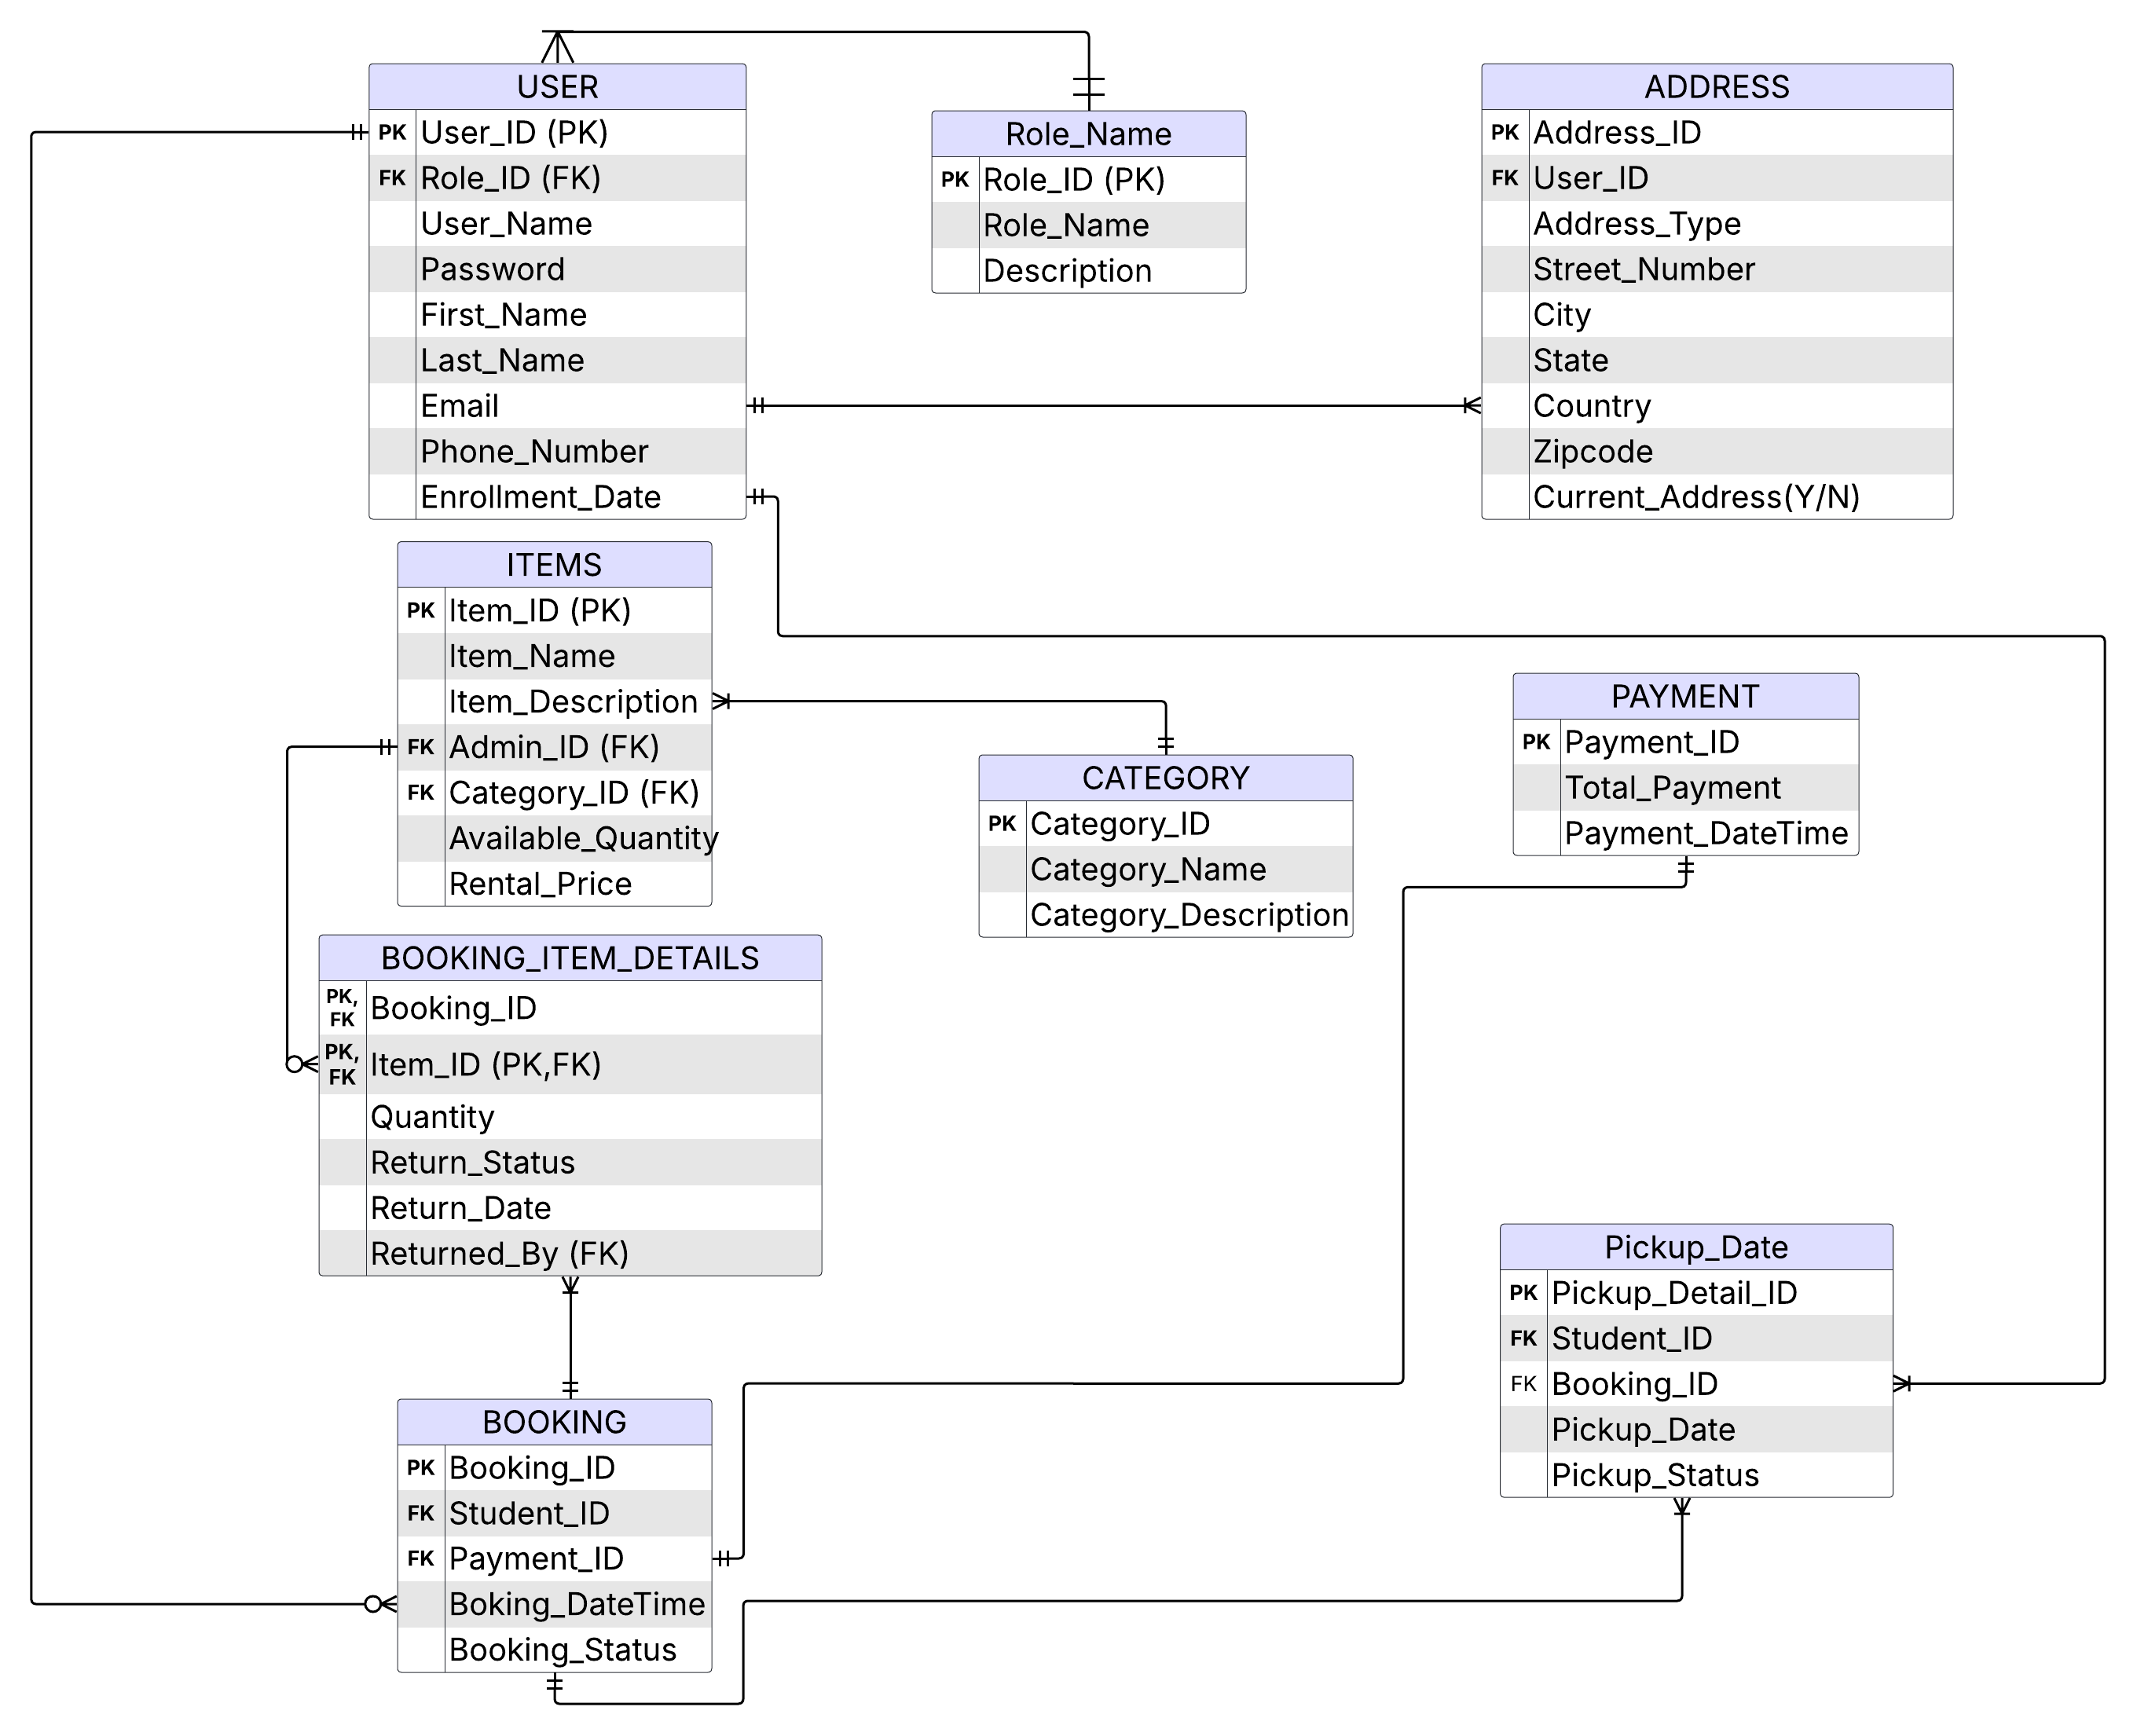
ERD

Slide 6
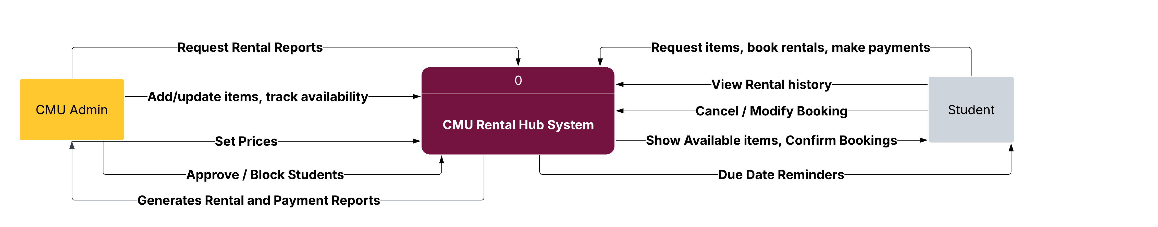
DFD Context Level

Slide 7
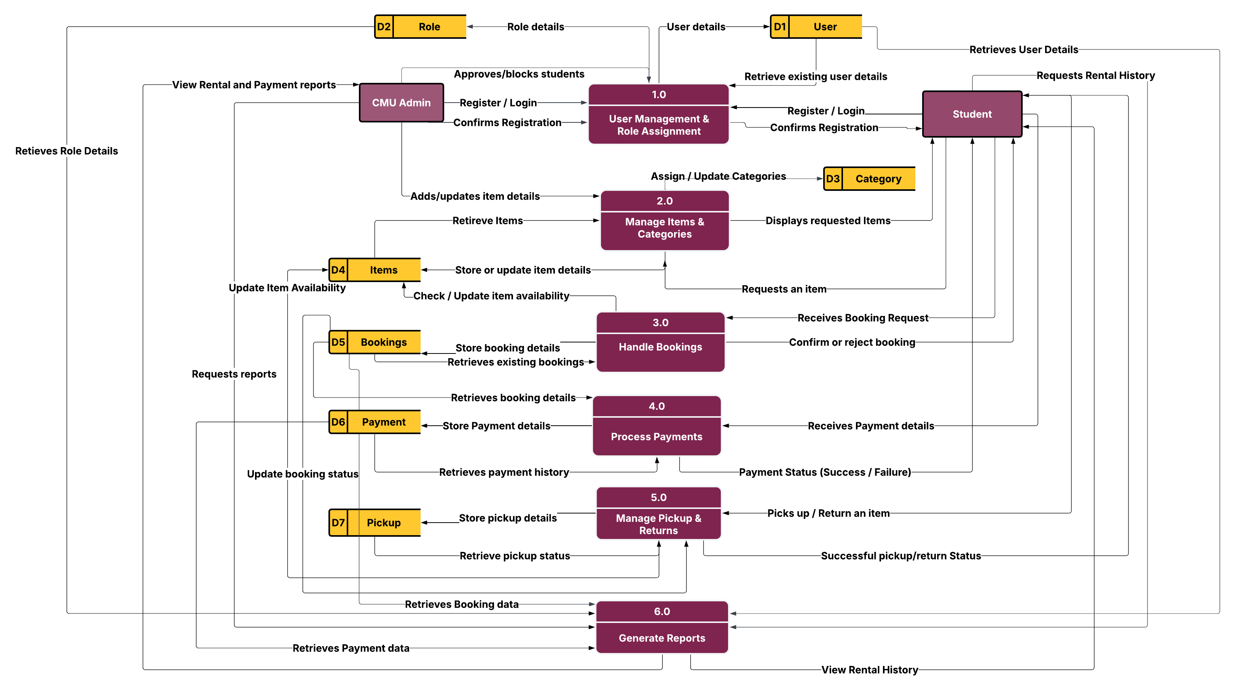
Level 0 DFD

Slide 8


